Slide 1

COFFEE SALES
&
FINANCIAL FORECASTING DASHBOARD
Team Name : Power Titans
Sagar K A
Aman Arora
Nimisha Rajendra
Sahana S

Slide 2

TABLE OF CONTENTS
1
Project Statement
11
Conclusion
2
Introduction to PowerBI
3
Financial Forecasting
1
4
About dataset
13
5
Project Objective
14
6
Dax formulas
7
Step To demonstrate Project
8
Visualizations
9
Future Enhancements
10
Milestone

Slide 3

PROJECT STATEMENT
Forecasting is a prediction with the same level of granularity as the data point used. After importing the dataset, temporal analysis via the built-in option involves using a line chart because it is essential to have a continuous temporal reference on the x-axis. On the y-axis, you will insert the aggregated measure, relative to the data point’s granularity level, for which we want to calculate the forecast.

Slide 4
INTRODUCTION
Definition: Power BI is a Business Intelligence tool used to clean the data, analyze the data and convert the data into visual format.
Overview of Power BI :
A Microsoft tool for visualizing data and sharing insights.
Offers interactive dashboards and easy data transformation.
Significance in Financial Visualization :
Tracks KPIs, identifies trends, and drives decisions.
Scope of the Project:
Create a Financial dashboard to analyze trends, monitor revenue, and evaluate performance.
Provide actionable insights to optimize strategies.

Slide 5
Financial Forecasting
Financial forecasting is the process of estimating or predicting a company's future financial outcomes based on historical data, trends, and assumptions.
Using Power BI for financial forecasting, the process includes:
Importing Historical Data: Bringing in data that contains past financial performance.
Temporal Analysis: Applying a time-based analysis, often using a line chart where the time dimension (e.g., months) is displayed on the x-axis. This time series allows for continuous visualization of data trends over time.
Aggregated Measures: Plotting measures such as revenue or profit on the y-axis, which can then be forecasted to predict future values based on historical patterns.
.

Slide 6

ABOUT THE DATASET
Key Attributes and Structure :
Attributes:
1. Area Code: Regional identifier.
2. COGS: Cost of goods sold.
3. Profit vs. Target: Financial performance comparison.
4. Date: Sales trend analysis.
5. Inventory Margin: Inventory efficiency.
6. Margin: Profit percentage.
7. Market Size: Customer base potential.
8. Profit: Financial gains after expenses.
9. Sales: Revenue generated.
Purpose of Selecting This Dataset :
Analyze sales, profit, and market trends.
Compare actual vs. target profits.
Optimize inventory and cost management.
Support data-driven decisions for better performance.

Slide 7
PROJECT PLAN & OBJECTIVES
Goals of the Dashboard Project:
Provide a comprehensive overview of sales and profit performance.
Compare actual profits against targets to evaluate financial success.
Analyze regional market trends and customer base potential.
Optimize inventory management and profitability metrics.
Key Insights Addressed :
Sales and profit trends over time.
Regional performance and market size analysis.
Inventory efficiency and profit margins.
Variance between actual and target profits.

Slide 8



Workflow
Data Collection and Loading
Data Cleaning and Transformation
Data Storage and Management
Data Analysis and Insights

Slide 9
APPLYING DAX FORMULAS
Key Performance Indicator
Total Profit : To calculate overall profit
TotalProfit = SUM(Coffee_Chain_Sales[Profit])
2.Total Revenue: Summed up sales figures to track overall performance.
TotalRevenue = SUMCoffee_Chain_Sales[ Sales])
3. Forecasted Revenue: To calculate overall forecasted revenue by considering 10%
ForecastedRevenue = [TotalRevenue] * 1.10

Slide 10
Step to Demonstrate project
Creating a financial forecasting dashboard in Power BI involves several steps, from importing data to building visualizations
Step 1: Import Data
Step 2: Transform Data (Data Cleaning and Preparation)
Step 3: Define Data Model and Relationships
Step 4: Create Visualizations for Temporal Analysis
Step 5: Add Additional Visualizations for Insight
Step 6: Build the Dashboard
Step 7: Publish and Share the Dashboard
Step 8: Review and Refine

Slide 11

DATA ANALYSIS

Slide 12
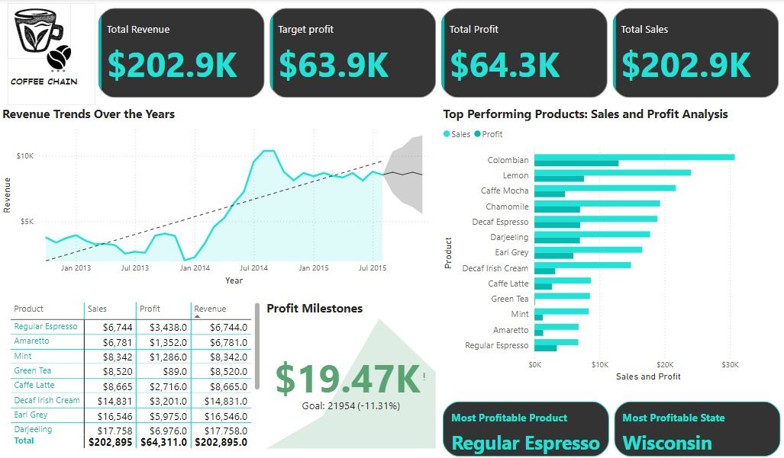
DASHBOARD OVERVIEW

Slide 13
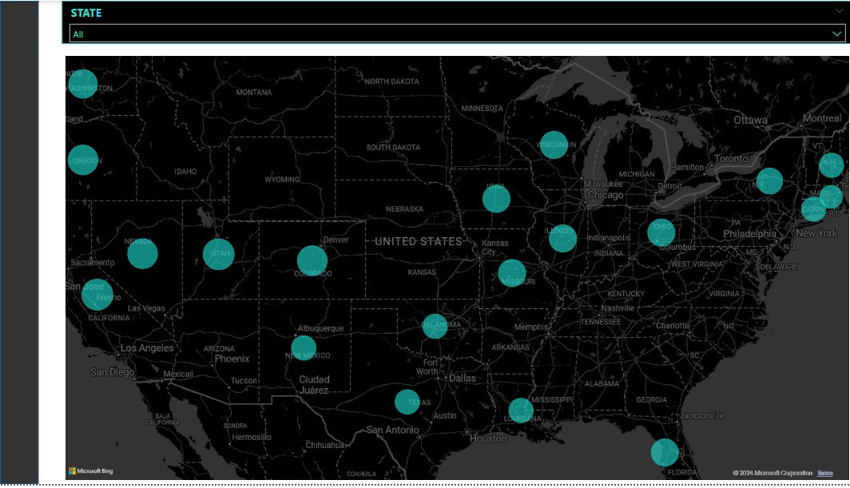
DASHBOARD OVERVIEW

Slide 14
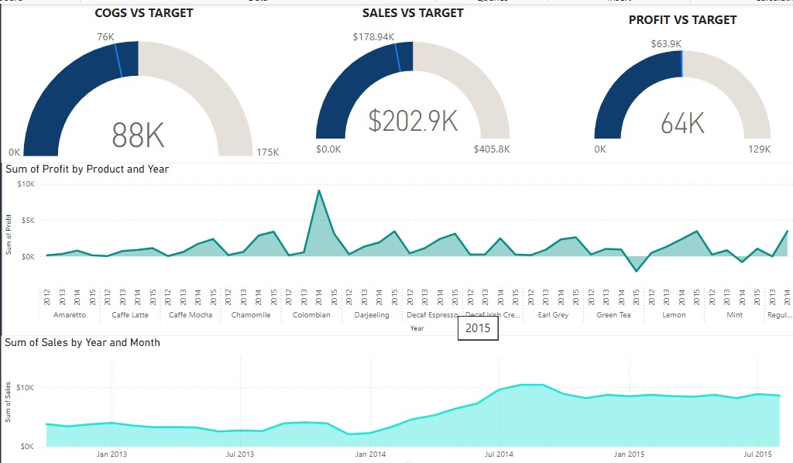
DASHBOARD OVERVIEW

Slide 15


OBSERVATION
Total Revenue: The coffee chain has generated a total revenue of $202.9K.
Total Profit: The company achieved a profit of $64.3K, meeting its financial objectives.
Revenue Trends:Sales and revenue show a consistent upward trend over the years, indicating growth in demand or improved market presence.
Top Performing Products:Colombian Coffee is the highest revenue and profit contributor, followed by Lemon and Caffe Mocha.Regular Espresso is identified as the most profitable product overall.
Profit Milestones: The company achieved $19.47K in profit for a specific period, which is 11.31% below the set goal of $21.95K.
Regional Insights:The state of Wisconsin is identified as the most profitable region.
Summary
This dashboard highlights the coffee chain’s strong financial performance, identifies the top-performing products and regions, and provides actionable insights into achieving growth targets and improving profitability. Further efforts can be made to optimize sales in underperforming products and meet profit milestones consistently.

Slide 16
FUTURE ENHANCEMENTS
Predictive Analytics Integration: Incorporate machine learning models to predict future sales trends and customer behavior.
Advanced Segmentation: Use clustering techniques to identify more granular segments.
Real-time Data Updates: Enable real-time data processing for live dashboards.
Geospatial Analysis: Add geospatial maps to visualize regional sales performance and trends dynamically.
Custom Alerts: Develop notifications for anomalies in sales, returns, or profit metrics.

Slide 17
MILESTONES
Milestone 1: Data Preparation Preparation
Milestone 2: Create time series visualization
Milestone 3: Implementing Forecasting Models
Milestone 4: Finalizing the Financial Forecasting Dashboard

Slide 18

CONCLUSION
The Sales Performance Dashboard provides a comprehensive view of sales trends, customer behavior, and product performance.
It enables data-driven decisions to optimize strategies and enhance profitability.
By analyzing key metrics like profit margins, return patterns, and regional sales, businesses can streamline operations, improve customer satisfaction, and maximize revenue.
This project highlights the potential of visual analytics tools like Power BI to transform raw data into valuable insights.

Slide 19

THANK
YOU!

